Slide 1

Improving Customer Acquisition at Gypsy Soul Holidays
Aarav Mody
22F3002269
‹#›

Slide 2


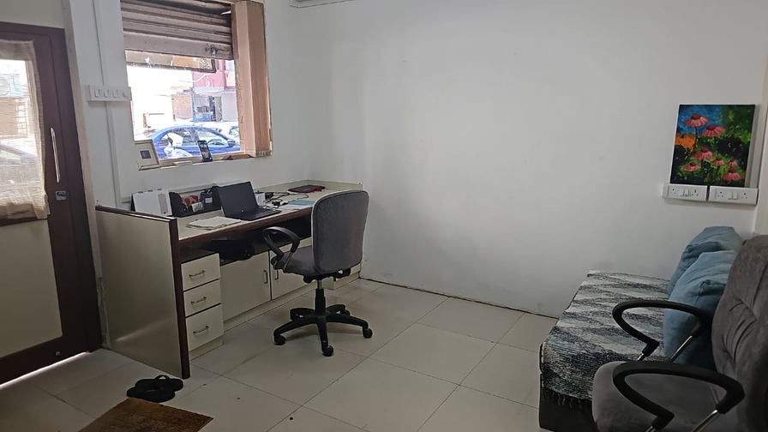
About the business
Gypsy Soul Holidays is B2C that deals directly with customers in the segment of travel.
Founded in the month of July in 2018 by Ms. Ashmi Dharia.
Focuses on premium, customised and tailormade holidays to destinations in India and around the world.
Provides various services like Complete packages, Tickets, Hotels, visas, etc.
‹#›

Slide 3

Challenges
Difficulty in persuading clients
Challenges in hiring workforce
Convince potential clients about its services.
Hire experienced workforce at a competitive pricing resulting in higher workload on the owner.

Slide 4
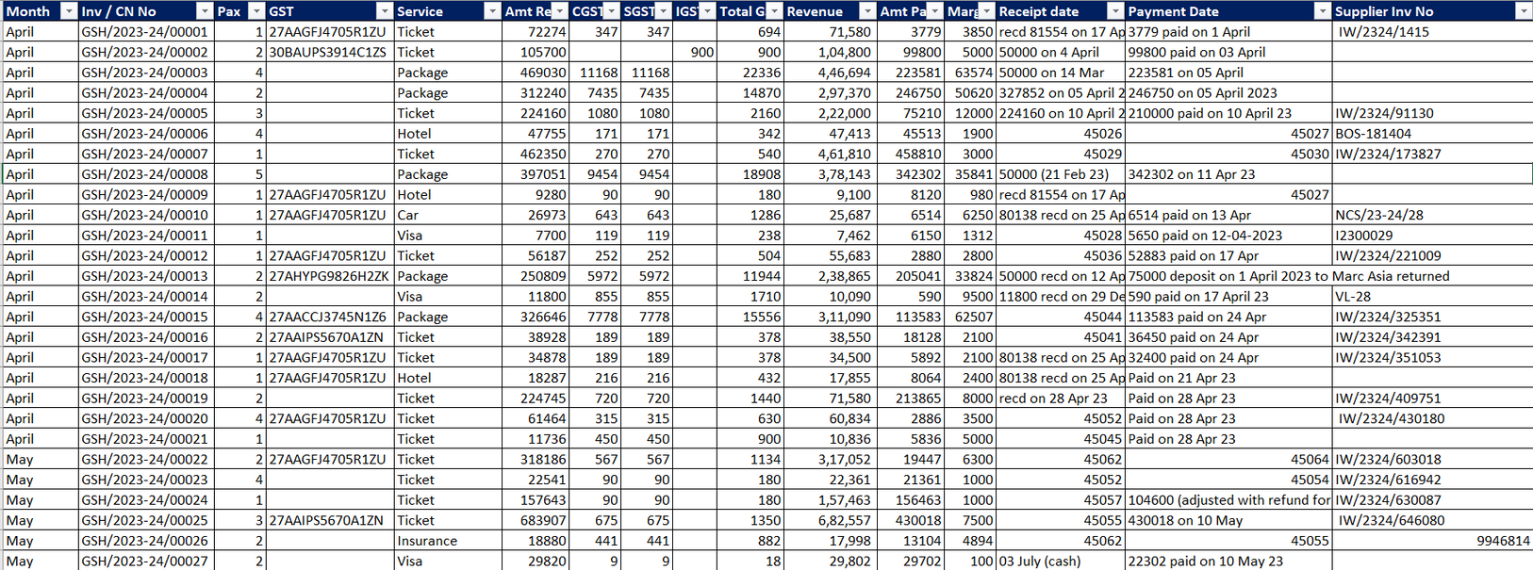

Data Overview
Data from April 2023 - March 2024
Cleaned for analysis
Date, Pax, Service, Amount Received, CGST, SGST, IGST, Margin : Important data for analysis

Slide 5
Analysis Methods
Revenue Contribution Analysis
Time Series Analysis
Profit Analysis
Profit Analysis
To find out which services result in the highest revenue.
Focus on increasing the sale for that service
Tracking the revenue and margin over the span of 12 months.
Find trends during peak and non-peak months
Insights on which service gives the highest margin
Streamlining the services accounting for maximum profits
Convince potential clients about its services.

Slide 6
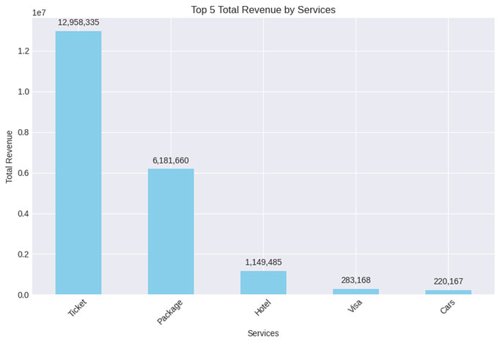
Revenue Contribution Analysis
The graph shows the top 5 services which account for total revenue
Tickets sales are found to have the maximum revenue with 1.29 cr INR.
Packages account to second most revenue with 61L INR.
‹#›

Slide 7
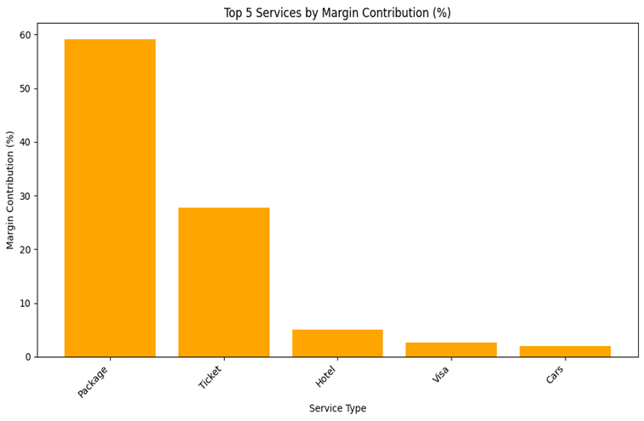
Profit Analysis
The graph shows the top 5 services which account for total profits
Tickets sales are found to have the maximum revenue however Package sales give more profit compared to any other services.
The startup should focus on selling more packages to its clients.
This can be done by turning ticket buyers into package buyers
‹#›

Slide 8
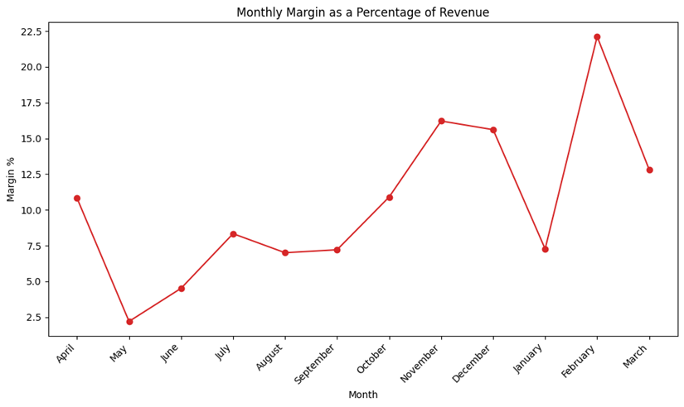
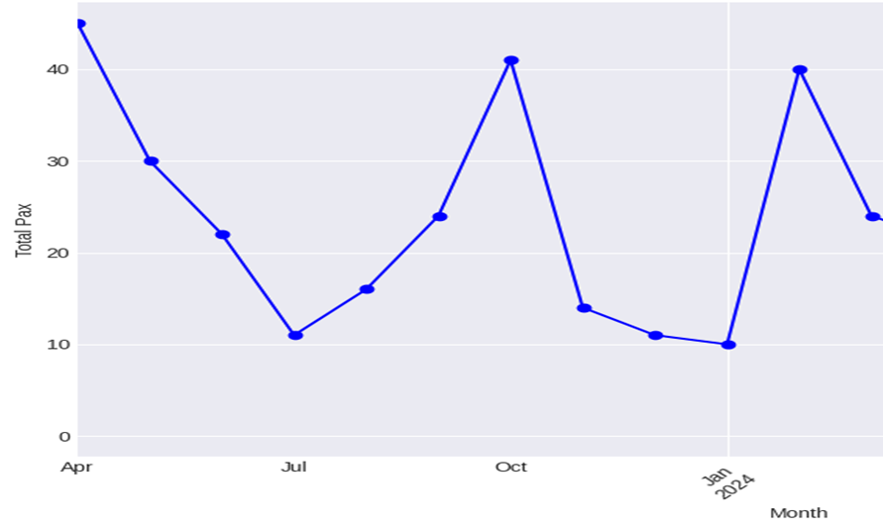
Time series Analysis
The graph shows the margin as a percentage of revenue of over the months
February shows the highest while may is the lowest.
The graph shows the number of people over the months
Pax count declines in May-July and post October
Gypsy Soul Holidays should look to target peak travel times: The three peaks in April, October and January indicate high demand.
‹#›

Slide 9
Recommendations
Utilize a Loss Leader Pricing Strategy on Ticket Sales
Reward Workforce with Conversion Bonuses
Offer Discounts and Loyalty Programs for Repeat Customers
Reduce margins on tickets to attract new customers and upsell higher-margin products like packages.
Commission-based bonuses to employees who convert ticket buyers into package customers to motivate and retain staff.
Implement loyalty programs or early-bird discounts to encourage repeat customers and smooth out revenue dips during off-peak seasons.
Set Up a Referral Program with Group Discounts
Hire Part-Time and Seasonal Workers During Peak Periods
Targeted Marketing
Create personalized marketing campaigns aimed at specific customer groups
Use targeted recruitment strategies to attract part-time workers during peak periods, focusing on specific demographics like students as interns and retirees.
Reward existing customers for referrals
Offer tiered group discounts to attract larger bookings
This increases organic word-of-mouth marketing.
Reduce salary costs by hiring part-time and seasonal workers during peak periods like festivals and summer vacations.

Slide 10
Thank you!

